Slide 1
DISTINCT
The relational model requires that every relation (table) should have no duplicate rows.
Query results using SELECT may produce duplicate rows.
Adding DISTINCT to the SELECT removes duplicate rows.
(Note that GROUP BY can also be used to remove duplicate rows.)
NOTE: DISTINCT applies to the combination of all columns.
E.g. If there are 3 columns in the result, then
the row 1 2 5
is distinct from
the row 1 2 6
DISTINCT can also be used inside aggregate functions.
Notes:
SQLNotDISTINCT.sql

Slide 2
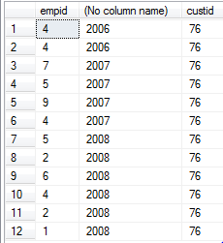
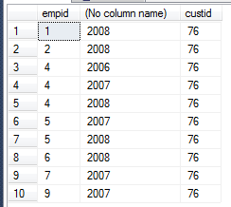
SELECT DISTINCT - Example
SELECT empid, SELECT DISTINCT empid,
YEAR(orderdate), custid YEAR(orderdate), custid
FROM Sales.Orders FROM Sales.Orders
WHERE custid = 76; WHERE custid = 76;
NOTE: DISTINCT applies to the COMBINATION
of empid, YEAR(orderdate), custid;
NOT just to empid.
Notes:
SQLNotDISTINCT.sql

Slide 3
DISTINCT and Aggregate Functions
Use the DISTINCT keyword in parentheses after the aggregate function name to apply it to distinct elements only.
E.g. if column X contains 3, 2, 2, 5, 2, 3 then:
SUM(X) returns 17.
SUM(DISTINCT X) returns 10 (3 + 2 + 5).

Slide 4
When to use DISTINCT?
Deciding whether to use DISTINCT often requires interpreting the intentions of the person requesting the information.
E.g. Show all the customer addresses.
Suppose there is more than one customer at the same address. Should that address be shown more than once or not?
If the intention is to contact each customer individually, then don’t remove duplicates.
If the intention is to send something to each address where there are customers, then duplicate addresses should be removed – use DISTINCT.
A good data analyst needs to think of these possibilities.

